Slide 1
APNIFFT & PAC 2022 SPEAKER GUIDELINES

Slide 2
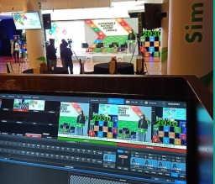
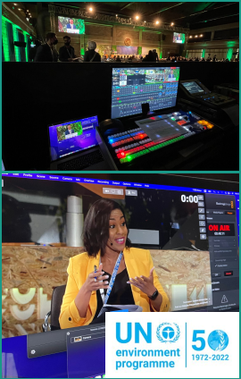
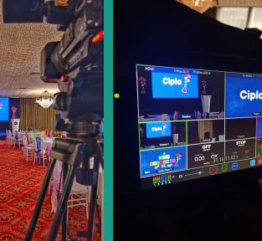
The Hybrid Meeting Format
The APNIFFT & PAC conferences will be run as hybrid events where we will combine the “live in-person” proceedings with “virtual online” participants
Both components will have
Speakers
Moderators
Panelists
Attendees
The technical team will merge the live & the virtual using a series of interfaces and the Zoom platform
To ensure seamless transition of presentations & videos they will be played from a central content machine on site
All sessions will be live-streamed for online participants
A recording of the sessions will also be done

Slide 3
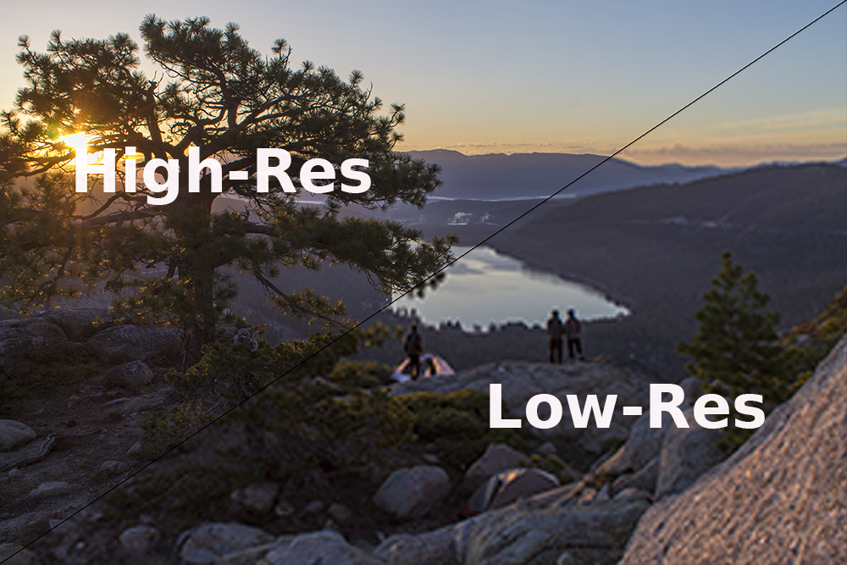
PowerPoint Slide Presentations
Avoid complicated visuals and text that require extensive reading by audience members
Make visuals attractive and easy to understand
Do NOT embed videos (if any) in the PowerPoint slide presentations, send them as separate files.
Use the 16:9 slide size ratio
Consistency is key with Fonts.
Title Font and Body font may differ, but keep the font size the same)
Ensure all images used are in high resolution to avoid pixelation on the display

Slide 4
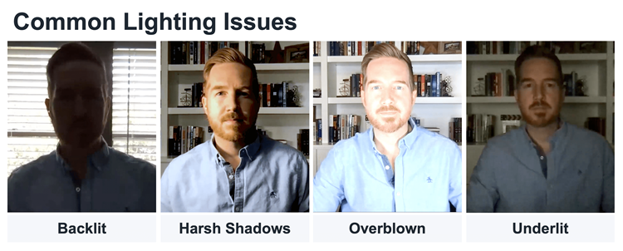
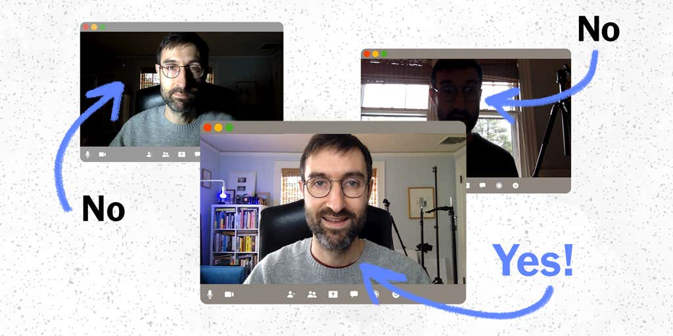
Speaker Videos (Live/Recorded)
Ensure you are visible and clear
Background should be neutral and not distracting for the audience
Ensure the light source is in front of you and not behind you
Ensure the camera angle is at eye level and that your lens is clean
Please do not wear clothes with busy prints (checks/squares)

Slide 5
Pre-recorded Videos: In case you have any pre recorded video;
Select a quiet area (as possible) and avoid areas that have an echo
Rooms should be fairly small
Sound dampening can be done with carpeting, curtains, furniture
If the default built-in microphone on computer is not producing good sound-quality, use a good headset with the microphone close to your mouth BUT away from direct line of mouth to reduce “pops”.
Do a test recording of a couple of minutes and review the sound and picture quality, MP4 format, and lighting before recording the entire presentation. Make adjustments if needed.
Resolution should be 1080p (Full High Definition FHD)
Video size should not exceed 1 GB.

Slide 6
In-Person Speakers/Moderators
Arrive to the Speaker Lounge 30 minutes prior to your session to allow for a walk-through with technical team to align on:
Program M.C
Camera placement in room
Microphone placement
Presentations & use of clicker
Any videos that need to be played
Seating arrangements
Translation considerations

Slide 7
Content Sharing Timeliness
Pre-recorded videos –
PowerPoint presentations –
Dry-run/Rehearsals –

